Slide 1
Types of Communication and Protocols

Slide 2
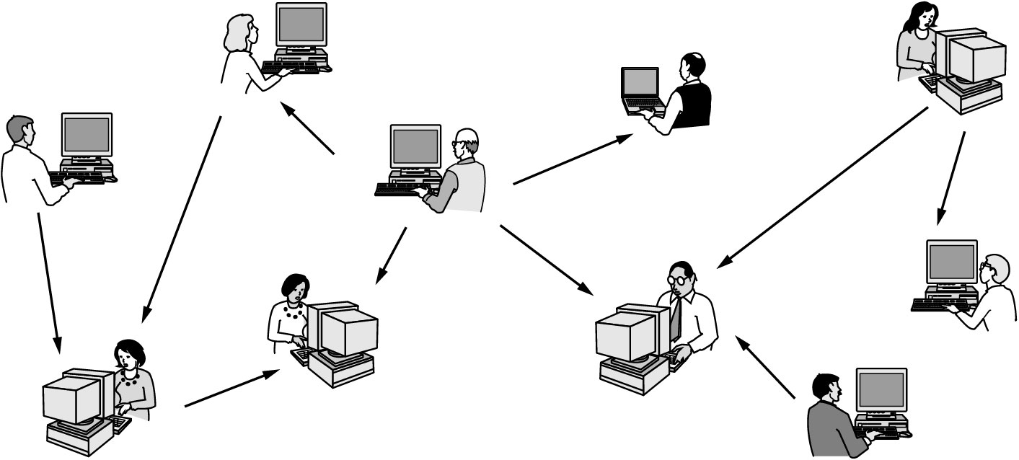
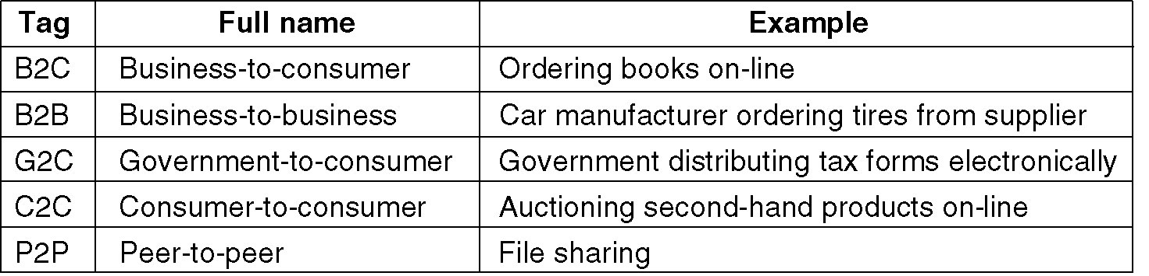
Why Computer Networks?
Application Type

Slide 3
Communications Tasks
Transmission system utilization | Addressing
Interfacing | Routing
Signal generation | Recovery
Synchronization | Message formatting
Exchange management | Security
Error detection and correction | Network management
Flow control

Slide 4
Types of Communication Networks
Classification according to the way the “information flows” are transported to the users
Switching Networks
Broadcast Networks
Notes:
4
DIMITRIOS MAKRAKIS, SITE, U OF O

Slide 5
Switching Networks
Data are transferred from source to destination through a series of intermediate nodes
Notes:
5
DIMITRIOS MAKRAKIS, SITE, U OF O

Slide 6


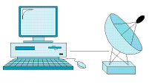

Broadcast Networks
--There are no intermediate switching nodes
--All users are connected on the same medium
Satellite
Notes:
6
DIMITRIOS MAKRAKIS, SITE, U OF O

Slide 7
Classification According to Coverage Area
Local Area Networks (0-2 Km; campus)
Ethernet (10/100/1000 Mbps), Token ring (4, 16 Mbps), IEEE 802.11(b, g, a, n)
Metropolitan Area Networks (2-50 km; corporate offices, city)
DQDB (Distributed Queue Dual Bus), WiMAX (IEEE 802.16.a/b/e)
Wide Area Networks (country, continent)
transmission lines, switching elements
Personal Access Networks (PANs)
Bluetooth, IEEE 802.15.3
Notes:
7
DIMITRIOS MAKRAKIS, SITE, U OF O

Slide 8
Local Area Networks (LANs)
It expands over small geographic areas (within a building or close-by buildings)
It is usually owned by the same organization
The internal data rates are typically much greater than those of WANs
Typically, they make use of broadcast rather than switching
Notes:
8
DIMITRIOS MAKRAKIS, SITE, U OF O

Slide 9
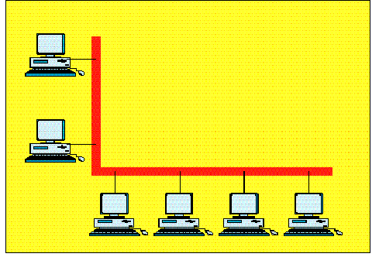
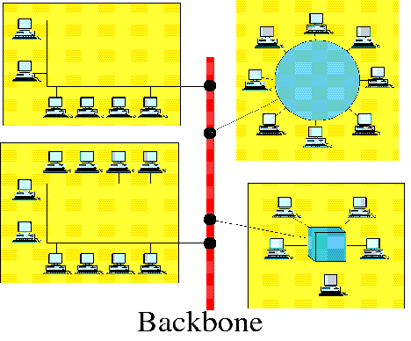
Local Area Networks (LANs)
Backbone
Single-building LAN
Multi-building LAN
Examples: home network, wireless-wired campus network
Notes:
9
DIMITRIOS MAKRAKIS, SITE, U OF O

Slide 10
Metropolitan Area Networks (MAN)
Examples: Ottawa-Carleton Research Institute (OCRI) MAN,
National Capital Institute on Telecommunications (NCIT) MAN
Notes:
10
DIMITRIOS MAKRAKIS, SITE, U OF O

Slide 11
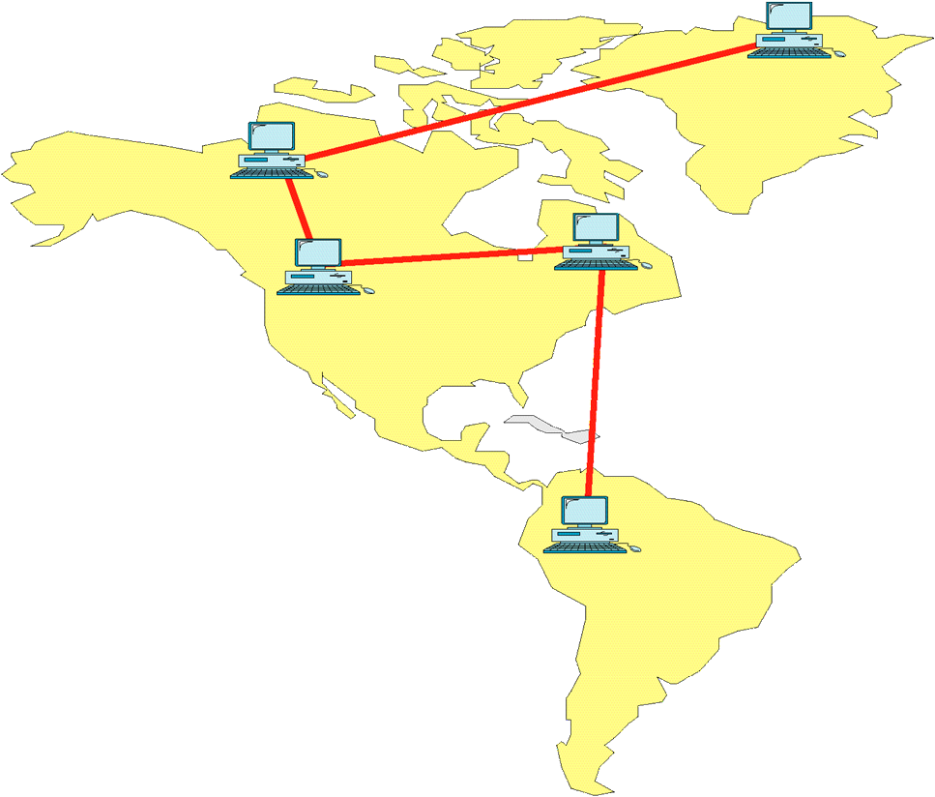
Wide Area Networks (WAN)
Example: Canadian Network for the Advancement of Research, Industry and Education (CANARIE).
Notes:
11
DIMITRIOS MAKRAKIS, SITE, U OF O

Slide 12
Wide Area Networks (WAN)
Traditionally, WANs have been implemented using one of two technologies
Circuit Switching
Packet Switching
Datagram
Virtual Circuit
Notes:
12
DIMITRIOS MAKRAKIS, SITE, U OF O

Slide 13
Circuit Switching
Uses a dedicated path between two stations
Process consists of three phases
establish
transfer
disconnect
Bandwidth inefficient
channel capacity dedicated for duration of connection
if no data, capacity wasted
Set up (connection) takes time
Once connected, transfer is transparent
Can provide deterministic performance guarantees
Notes:
13
DIMITRIOS MAKRAKIS, SITE, U OF O

Slide 14
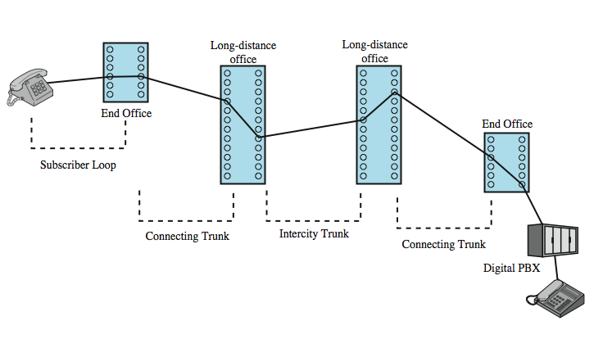
Circuit Switching Network
Example: Public Service Telephone Network (PSTN)
Notes:
14
DIMITRIOS MAKRAKIS, SITE, U OF O

Slide 15
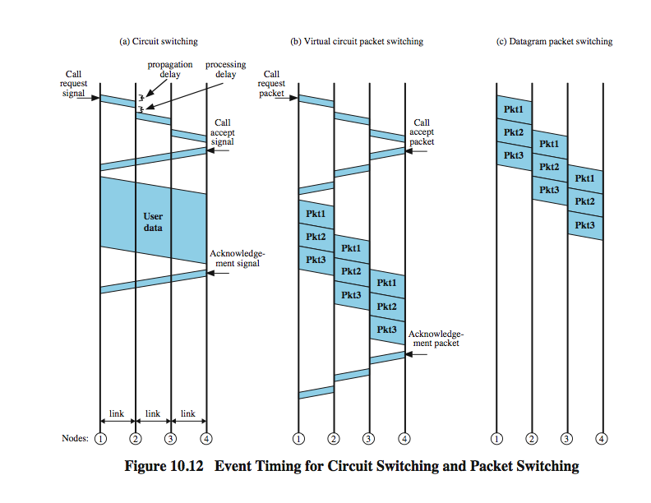



Event Timing for Circuit Switching
Notes:
15
DIMITRIOS MAKRAKIS, SITE, U OF O

Slide 16
Packet Switching
circuit switching was designed for voice
packet switching was designed for data
transmitted in “small” packets
packet contains user data and control info
user data may be part of a larger message
control info includes routing (addressing) info
packets are received, stored briefly (buffered) and passed on to the next node
Notes:
16
DIMITRIOS MAKRAKIS, SITE, U OF O

Slide 17
Packet Switching
Source breaks long message into “information transporting segments” (packets).
Packets are sent one at a time to the network.
Packets contain user data and control/signaling information.
user data may be part of a larger message
control information includes routing/addressing information
Packets are received, stored “briefly” (buffered) and are passed onto the next node.
Notes:
17
DIMITRIOS MAKRAKIS, SITE, U OF O

Slide 18
Characteristics
Line efficiency
single link shared by many packets over time
packets queued and transmitted as fast as possible
Data rate conversion
stations connect to local nodes at their own speed
nodes buffer data if required to equalize rates
Packets are accepted even when the “line” is busy
Priorities can be used to support users’ needs, instead of dedicating resources regardless if they are used or not (becoming wasted if they are not)
Notes:
18
DIMITRIOS MAKRAKIS, SITE, U OF O

Slide 19
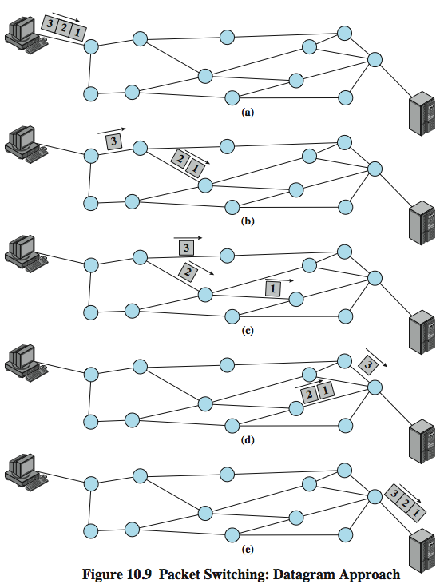
Datagram Packet Switching
19
Notes:
19
DIMITRIOS MAKRAKIS, SITE, U OF O

Slide 20
Event Timing for Datagram
Notes:
20
DIMITRIOS MAKRAKIS, SITE, U OF O

Slide 21
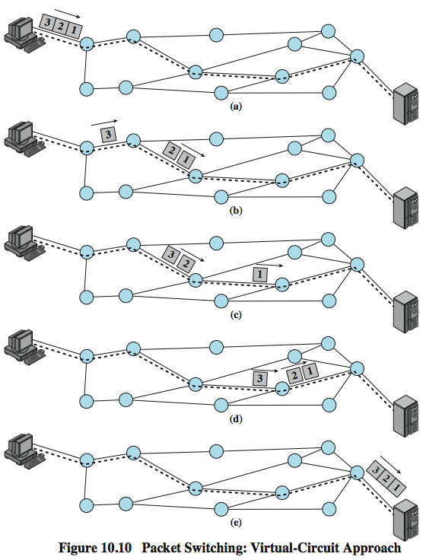
Virtual Circuit Packet Switching
Notes:
21
DIMITRIOS MAKRAKIS, SITE, U OF O

Slide 22
Event Timing for the 3 switching methods
Notes:
22
DIMITRIOS MAKRAKIS, SITE, U OF O

Slide 23
Virtual Circuits versus Datagram
Virtual circuits
network can provide sequencing
traffic engineering can be applied, enabling more practical provision of quality of service (QoS) support
less reliable in cases of switching node failures
Datagram
no call setup phase
more flexible
more reliable in cases of switching node failures
difficult to control network’s state and provide quality of service1
Notes:
23
DIMITRIOS MAKRAKIS, SITE, U OF O

Slide 24
Circuit versus Packet Switching: Comparison
Circuit Switching
Dedicated channels/resources
Constant delay
Blocking
Continuous flow
Point-to-Point
Packet Switching
Shared channels
Variable delay
Store-and-forward point-to-point & multipoint
Notes:
24
DIMITRIOS MAKRAKIS, SITE, U OF O

Slide 25
Other forms of Packet Switching Services
Frame Relay based Networks
requires high level of network reliability.
took away a lot of overhead, improved efficiency.
Asynchronous Transfer Mode (ATM)
based on the use of fixed size packets (53 bytes, called ATM cells).
first Broadband Integrated Services (ISDN) network .
offered quality of service (QoS) choices.
MPLS (label switching)
Notes:
25
DIMITRIOS MAKRAKIS, SITE, U OF O

Slide 26
Internetworking
Internetworking is a scheme for interconnecting multiple networks of non identical technologies
Uses both hardware and software
Extra hardware positioned between networks
Software on each attached computer
System of interconnected networks is called an internetwork or an internet
Notes:
26

Slide 27
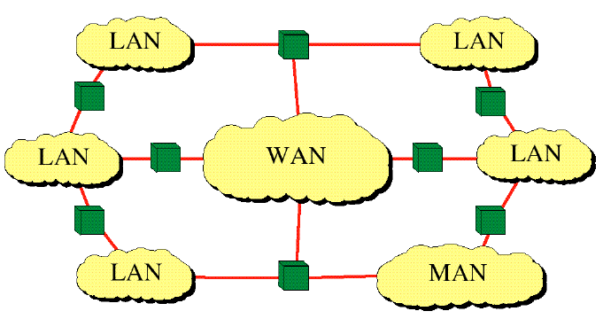
Internetwork (Internet)
Notes:
27
DIMITRIOS MAKRAKIS, SITE, U OF O

Slide 28
What is a protocol ?

Slide 29
Protocols
A protocol is a set of rules that govern all aspects of communication between two or more partners, called peers
These rules are human-made; not like chemistry or physics!
The purpose of a protocol is to provide a specific communication service.
What aspects must be defined for assuring compatibility between the communicating partners? (see next slides)
Who makes protocols?
Standardization committees
Designers of a new distributed application

Slide 30
Types of Protocols
Network Communications Protocols
Network Security Protocols
Routing Protocols
Service Discovery Protocols

Slide 31
Network Communications Protocols
Protocols enable two or more devices to communicate over one or more networks. The Ethernet family of technologies involves a variety of protocols such as IP, Transmission Control Protocol (TCP), HyperText Transfer Protocol (HTTP), and many more.
TCP/IP, SMTP, PPP, FTP, SFTP, HTTP, HTTPS, TELNET, POP3, IPv4, IPv6, ICMP, UDP, IMAP, SSH, Gopher

Slide 32
Network Security Protocols
Protocols secure data to provide authentication, data integrity, and data encryption. Examples of secure protocols include Secure Shell (SSH), Secure Sockets Layer (SSL), and Transport Layer Security (TLS).

Slide 33
Routing Protocols
Protocols enable routers to exchange route information, compare path information, and then to select the best path to the destination network. Examples of routing protocols include Open Shortest Path First (OSPF) and Border Gateway Protocol (BGP).

Slide 34
Service Discovery Protocols
Protocols are used for the automatic detection of devices or services. Examples of service discovery protocols include Dynamic Host Configuration Protocol (DHCP) which discovers services for IP address allocation, and Domain Name System (DNS) which is used to perform name-to-IP address translation.

Slide 35
Relevant Standards Bodies
ISO (www.iso.org)
An agency of the United Nations.
Collaborates standards development for information technology.
ITU (www.itu.int)
UN treaty agency that sets telecommunications standards.
ITU-T (Telecommunications section)
ANSI (www.ansi.org)
American National Standards Institute: the US national standards body.
Coordinates and accredits standards development across the US.
IEEE (www.ieee.org)
US based international professional organization.
Among other things, develops standards.
IETF / IRTF
Internet Engineering Task Force (www.ietf.org)
Internet Research Task Force (www.irtf.org)
EIA (www.eia.org)
Electronic Industries Alliance
E.g.; standards for wiring and interconnection

Slide 36
OSI Model
Open System Interconnection.
An ISO standard
Why open?

Slide 37
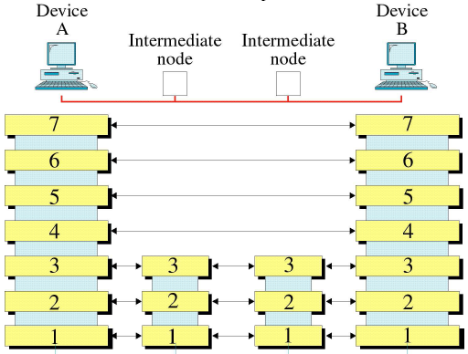
OSI Reference Model
Application
Presentation
Session
Transport
Network
Link
Physical
Notes:
37
DIMITRIOS MAKRAKIS, SITE, U OF O

Slide 38
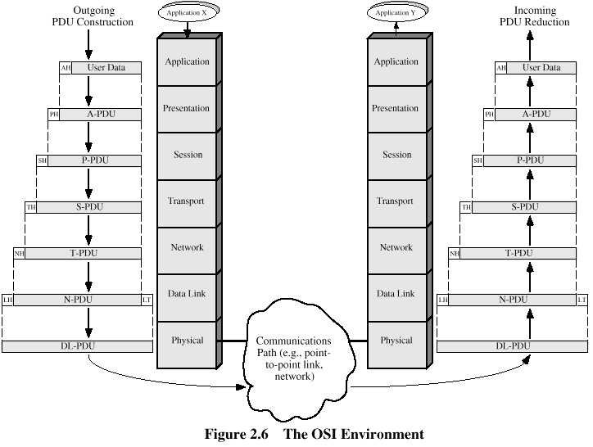
Protocol Data Unit (PDU)

Slide 39
TCP/IP Protocol Architecture
No official model but a working one.
Has 5 layers (OSI has 7 layers)
Was the result of research conducted on ARPANET, funded by DARPA (USA).
Initially developed as a US military research effort funded by the Department of Defense
It has dominated.
It is the “heart” of Internet.
Notes:
39
DIMITRIOS MAKRAKIS, SITE, U OF O

Slide 40
TCP/IP Protocol Architecture
Contains the logic needed to support user applications (ftp, telnet, http etc.) Each application requires different module.
Application Layer
Host-to-Host
or Transport Layer
Concerned with the reliability of transmission/reception (error control, sequencing, flow control)
Internet Layer
Provides routing functions across multiple networks. It is implemented in end-systems and routers
Network Access Layer
Concerned with the exchange of data between end system and network (destination address, priority etc.) Depends on net. type
Covers the physical interface between device (computer and transmission medium or network - medium, signals, data rates..)
Physical Layer
Notes:
40
DIMITRIOS MAKRAKIS, SITE, U OF O

Slide 41
TCP/IP Protocol Architecture
Application Layer
Application Layer
Host-to-Host
or Transport Layer
Host-to-Host
or Transport Layer
Internet Layer
Internet Layer
Network Access Layer
Network Access Layer
Network
Physical Layer
Physical Layer
Notes:
41
DIMITRIOS MAKRAKIS, SITE, U OF O

Slide 42
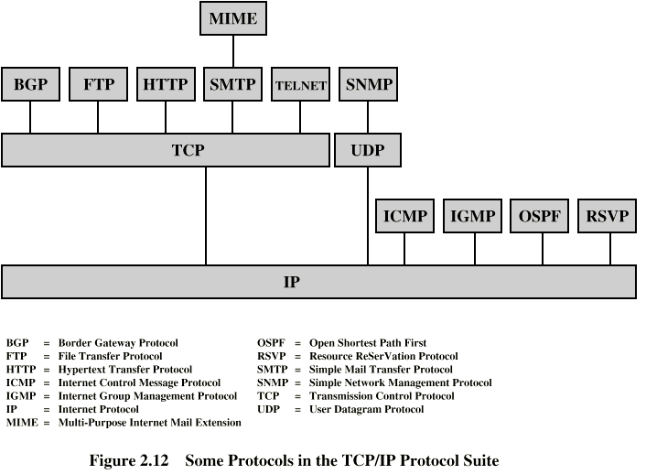
Some TCP/IP Protocols
Notes:
42

Slide 43
IEEE Project 802 - LAN
Network access service interface

Slide 44
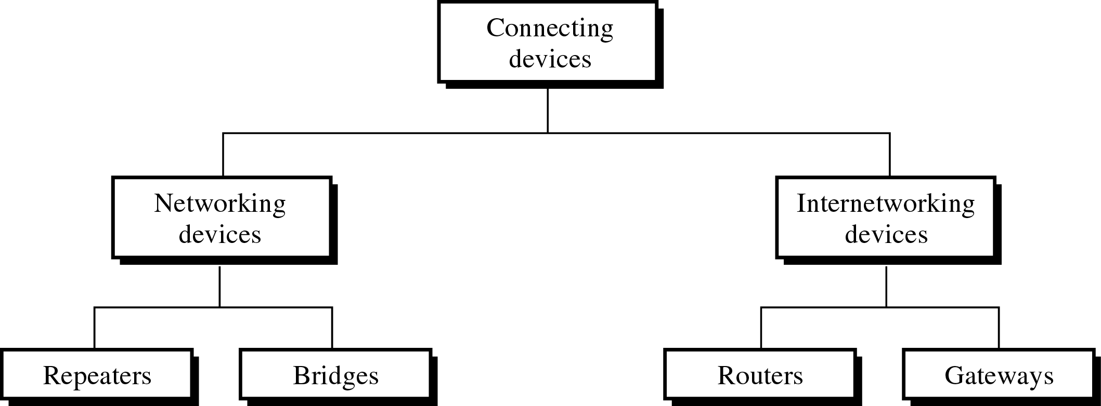
Connection Devices

Slide 45
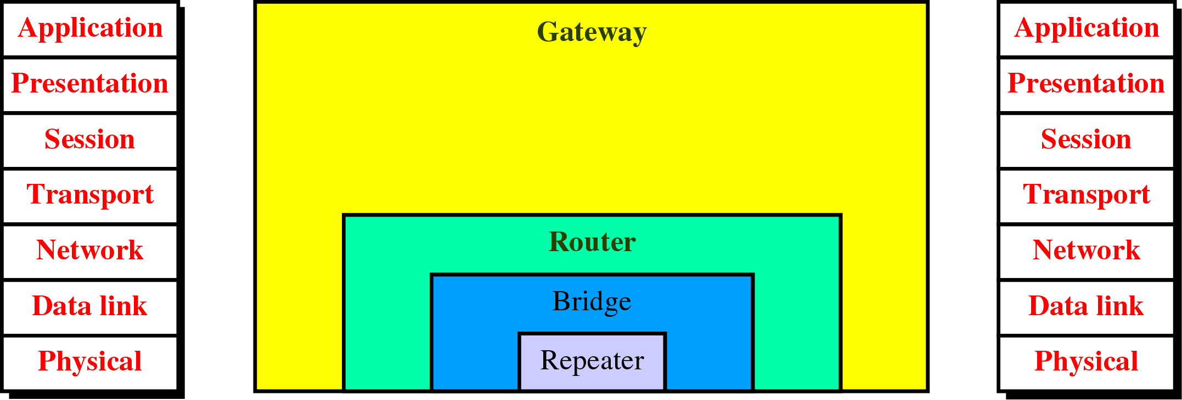
Connecting Devices and the OSI Model

Slide 46
Repeater
A repeater operates at the physical layer.
Its job is to regenerate the signal over the same network before the signal becomes too weak or corrupted to extend the length to which the signal can be transmitted over the same network.
An important point to be noted about repeaters is that they do not amplify the signal. When the signal becomes weak, they copy it bit by bit and regenerate it at its star topology connectors connecting if original strength. It is a 2-port device.
Notes:
A repeater operates at the physical layer. Its job is to regenerate the signal over the same network before the signal becomes too weak or corrupted to extend the length to which the signal can be transmitted over the same network. An important point to be noted about repeaters is that they do not amplify the signal. When the signal becomes weak, they copy it bit by bit and regenerate it at its star topology connectors connecting if original strength. It is a 2-port device.

Slide 47
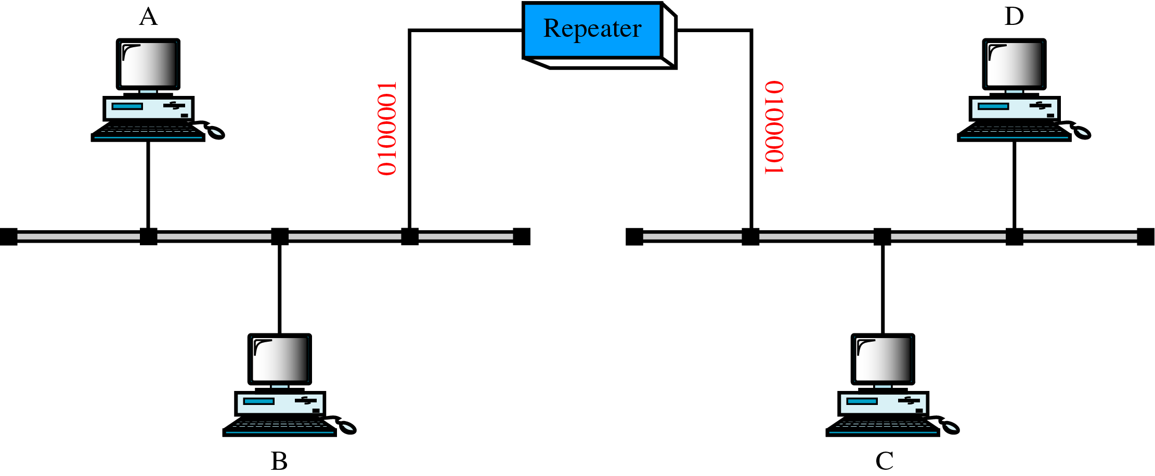
Repeater
A Repeater
Notes:
A repeater operates at the physical layer. Its job is to regenerate the signal over the same network before the signal becomes too weak or corrupted to extend the length to which the signal can be transmitted over the same network. An important point to be noted about repeaters is that they do not amplify the signal. When the signal becomes weak, they copy it bit by bit and regenerate it at its star topology connectors connecting if original strength. It is a 2-port device.

Slide 48
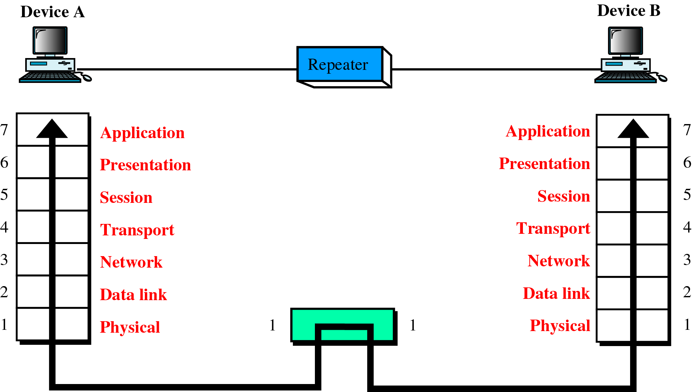
Repeater Contd…

Slide 49
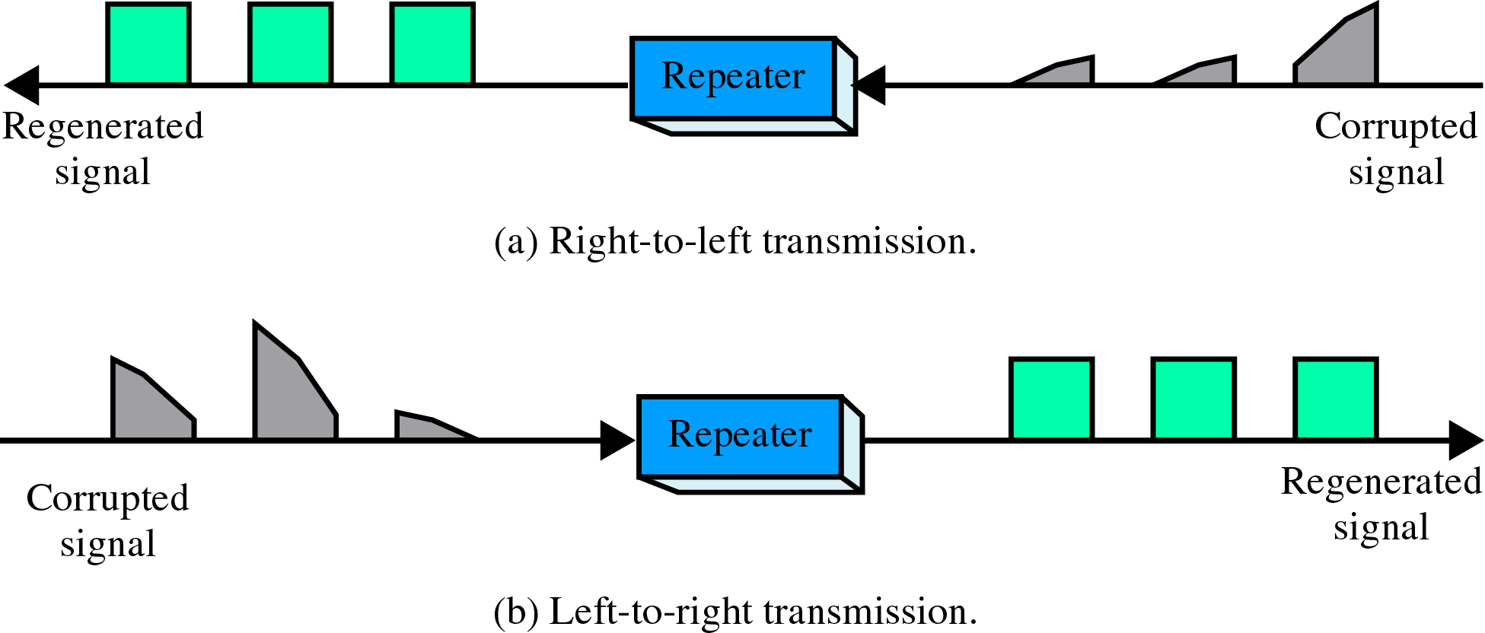
Function of Repeater

Slide 50
Bridge
A bridge operates at the data link layer. A bridge is a repeater, with add on the functionality of filtering content by reading the MAC addresses of the source and destination. It is also used for interconnecting two LANs working on the same protocol. It has a single input and single output port, thus making it a 2 port device.

Slide 51
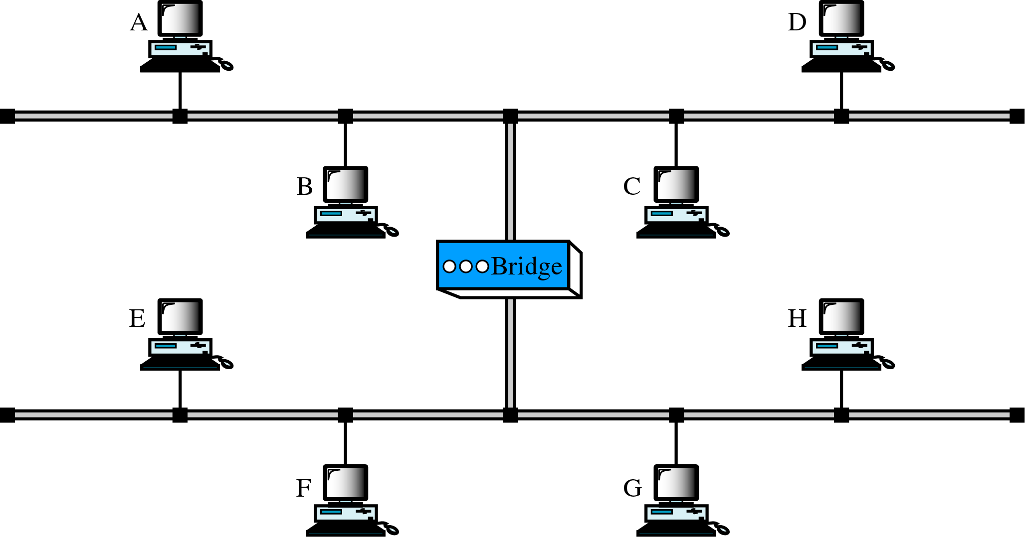
Bridge
Notes:
Bridge – A bridge operates at the data link layer. A bridge is a repeater, with add on the functionality of
filtering content by reading the MAC addresses of the source and destination. It is also used for
interconnecting two LANs working on the same protocol. It has a single input and single output port, thus
making it a 2 port device.

Slide 52
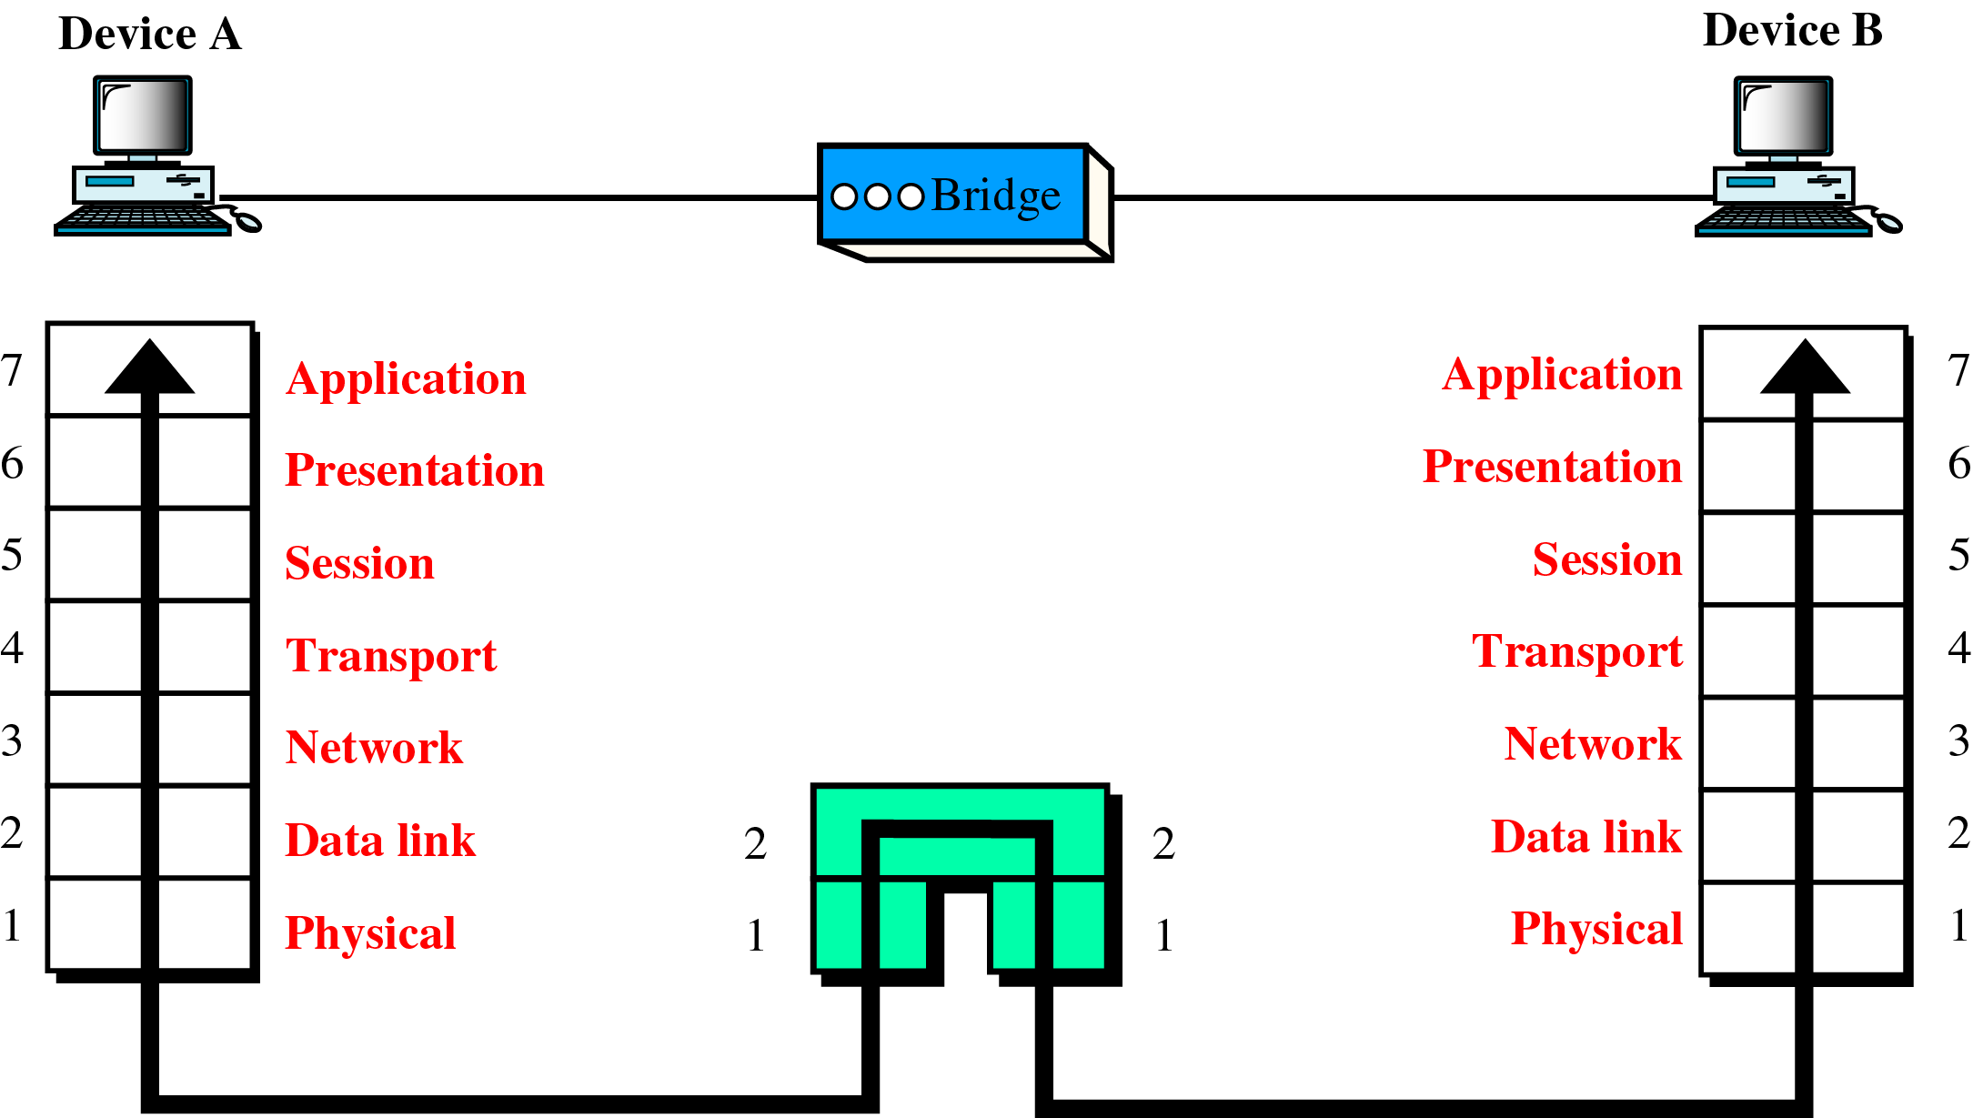
Bridge Contd…

Slide 53
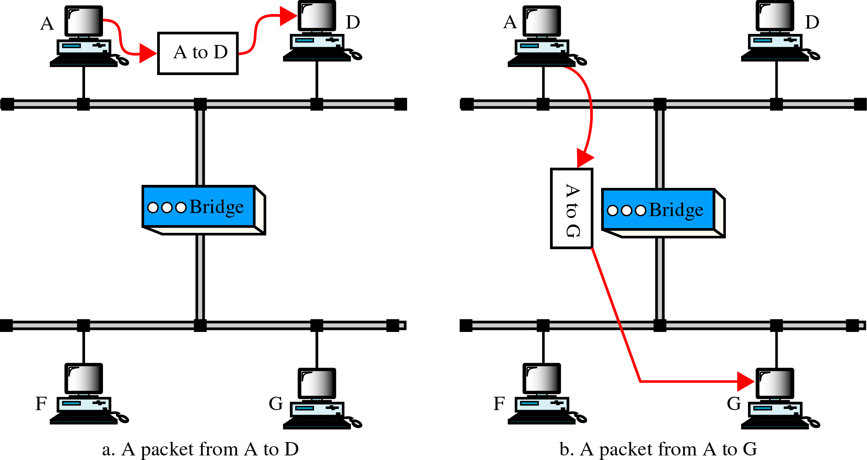
Function of Bridge

Slide 54
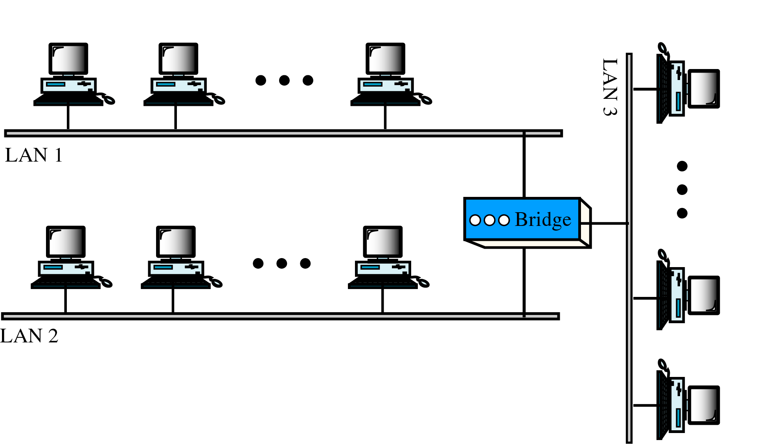
Multiport Bridge

Slide 55
Routers
A router is a device like a switch that routes data packets based on their IP addresses.
The router is mainly a Network Layer device.
Routers normally connect LANs and WANs and have a dynamically updating routing table based on which they make decisions on routing the data packets.
The router divides the broadcast domains of hosts connected through it.

Slide 56
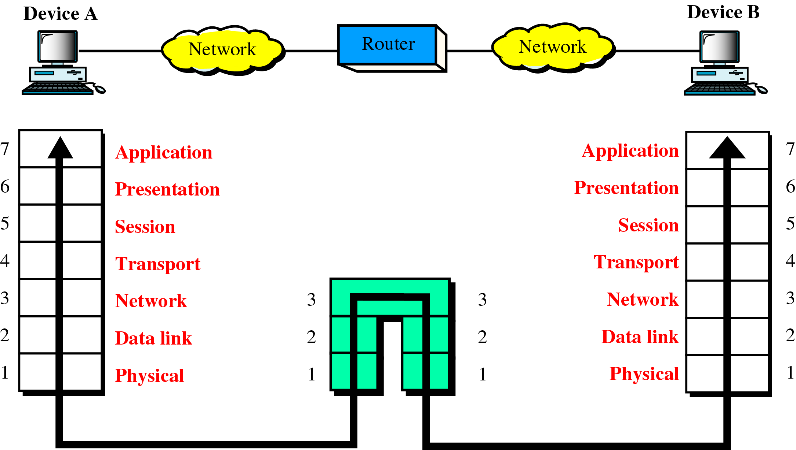
Router

Slide 57
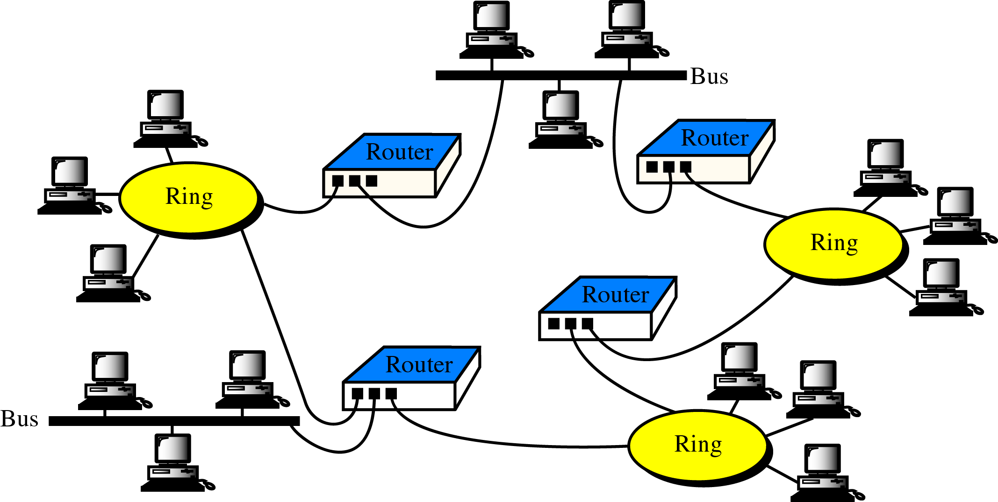
Routers in an Internet

Slide 58
Gateway
A gateway, as the name suggests, is a passage to connect two networks that may work upon different networking models. They work as messenger agents that take data from one system, interpret it, and transfer it to another system. Gateways are also called protocol converters and can operate at any network layer. Gateways are generally more complex than switches or routers. A gateway is also called a protocol converter.

Slide 59
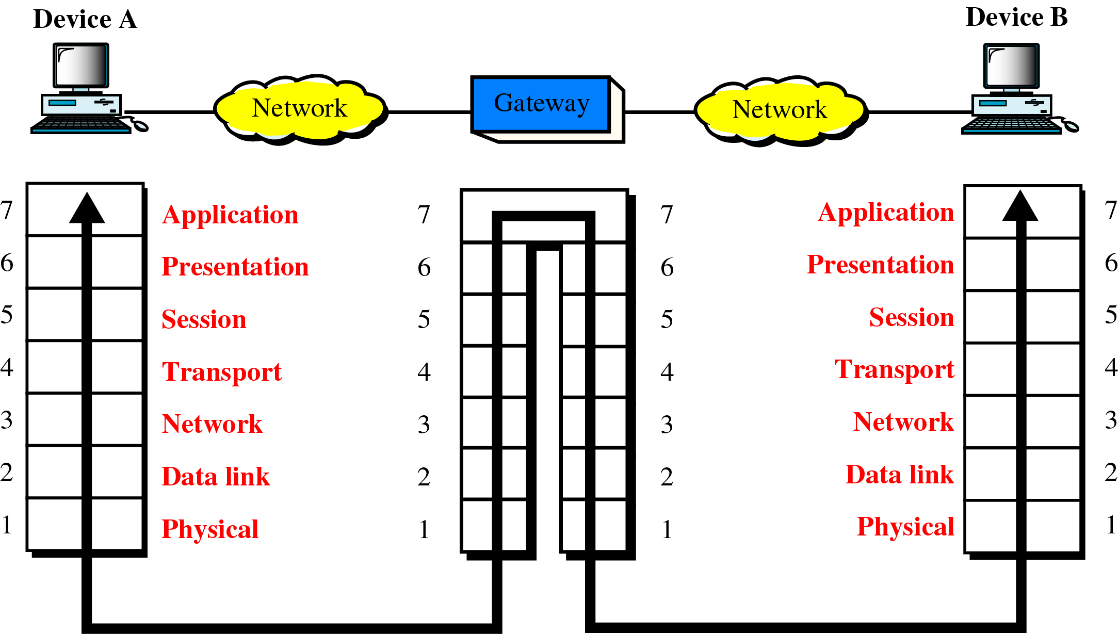
Gateway

